Slide 1
Monitor your VCSA through the new vCenter REST APIs #VMTN5080E
Rudi Martinsen Senior Systems Engineer, Proact IT Norge AS
@RudiMartinsen

Slide 2
About me..
Rudi Martinsen
Senior Systems Engineer, Proact IT Norge AS
Automation and integration
Infrastructure and performance monitoring
vExpert 2018-2019
VMUG Norway Leader
Twitter: @RudiMartinsen
Blog: rudimartinsen.com

Slide 3
Agenda
vSphere performance monitoring – a short recap
vSphere APIs – a short introduction
Exploring vCenter REST APIs
Extending the Performance monitoring solution

Slide 4
vSphere Performance monitoring – Short recap

Slide 5

vSphere Performance monitoring – Short recap
Pull
vCenter

Slide 6


vSphere Performance monitoring – Short recap
Pull
vCenter
Store

Slide 7
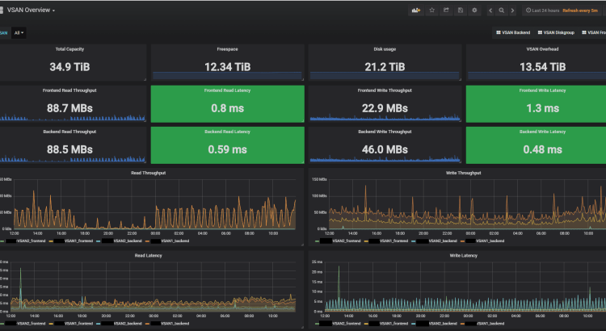

vSphere Performance monitoring – Short recap
Pull
vCenter
Visualize
Store

Slide 8


vSphere Performance monitoring – Short recap
Pull
SAN
vCenter
Visualize
Store

Slide 9
Demo

Slide 10
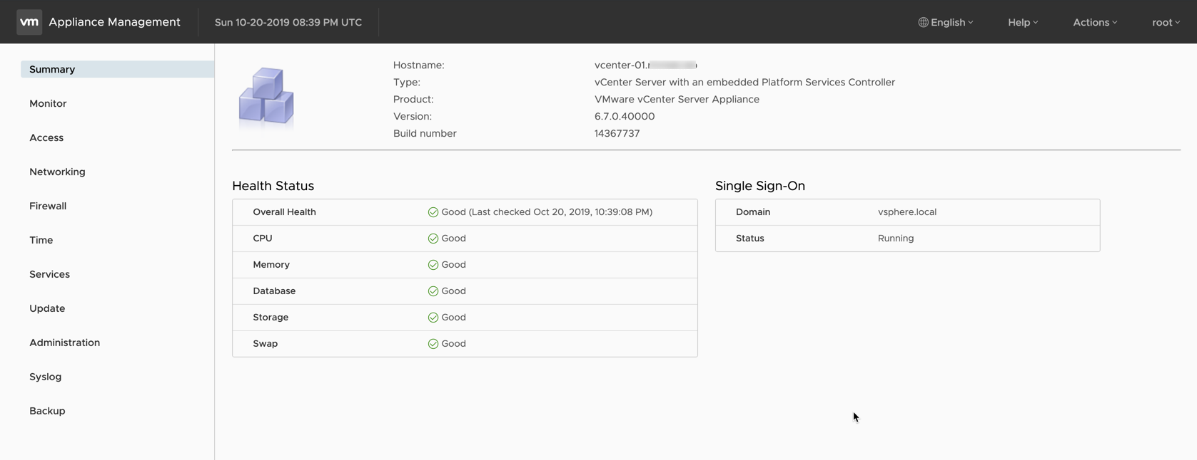
VCSA Management - VAMI

Slide 11
vSphere APIs
Until recently most vSphere APIs where SOAP based
SOAP vs REST
Most of the SDK’s (PowerCLI, RbVmomi, PyVmomi, etc) uses these APIs
With vSphere 6.5 vCenter shipped with a shiny new REST API
Further extended in 6.7, 6.7 U1 and 6.7 U2
SOAP and REST will co-exist for a (long) while
Some of the new stuff will only be available through REST
https://www.upwork.com/hiring/development/soap-vs-rest-comparing-two-apis/

Slide 12
Exploring the vSphere APIs
https://code.vmware.com/
Postman collections
https://<your-vcsa>/apiexplorer, in 6.7 U2 inside vCenter!
Powershell, curl etc

Slide 13
Demo

Slide 14
Extending the performance monitoring solution

Slide 15
Extending the performance monitoring solution
Pull
SAN
vCenter
Visualize
Store

Slide 16

Extending the performance monitoring solution
Pull
SAN
VCSA
vCenter
Visualize
Store

Slide 17
VCSA Management - VAMI

Slide 18
Demo

Slide 19
Resources
https://www.rudimartinsen.com/vsphere-performance/
https://www.rudimartinsen.com/2018/12/03/vsphere-performance-vcenter-server-appliance-vcsa-monitoring/
https://www.influxdata.com/time-series-platform/influxdb/
https://grafana.com/
https://code.vmware.com/apis
https://github.com/vmware/vsphere-automation-sdk-rest/tree/master/samples/postman
https://github.com/rumart/vmworld-europe-19

Slide 20
Thank you
@RudiMartinsen | https://rudimartinsen.com | rudi.martinsen@proact.no

